Slide 1
TeeJay Mural Renovation Project Completed!
A News Update
8/7/15
A 2015 summer Thomas Jefferson Viking Fund project

Slide 2
FYI -- TeeJay Mural Renovation Project
This summer the Julien Binford mural in the TeeJay library was restored to its previous greatness through the efforts of The Viking Fund, an independent, tax exempt organization composed of multi -class alumni, community neighbors of the school, and other partners interested in helping Thomas Jefferson High School in a myriad of ways. This summer’s mural renovation project is just one of those ways we thought you’d want to know about.
We recognize the good works of The Viking Fund and appreciate all that they do.

Slide 3
TeeJay Mural Renovation Project

Slide 4
Tee Jay Mural Renovation Project Cont’d: A little history about the mural…
In 1941, the Richmond Times Dispatch reported a competition to select an artist to design and paint a mural to be erected in the school’s library.
The mural was painted as a memorial to Milton Marcuse Stern, a Tee Jay honor student who died shortly after graduation in 1940.
Funding for the mural’s total costs ($800), were donated by Stern’s aunt and uncle, Mr. & Mrs. Milton Marcuse.
A robust competitive process selected Julien Binford to design and paint the mural.

Slide 5
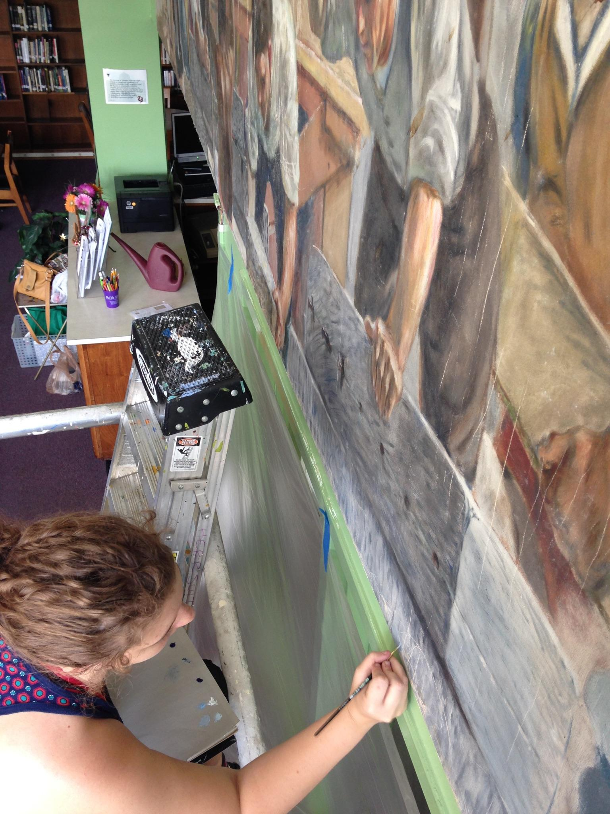
TeeJay Mural Renovation Cont’d

Slide 6
During renovation process.

Slide 7
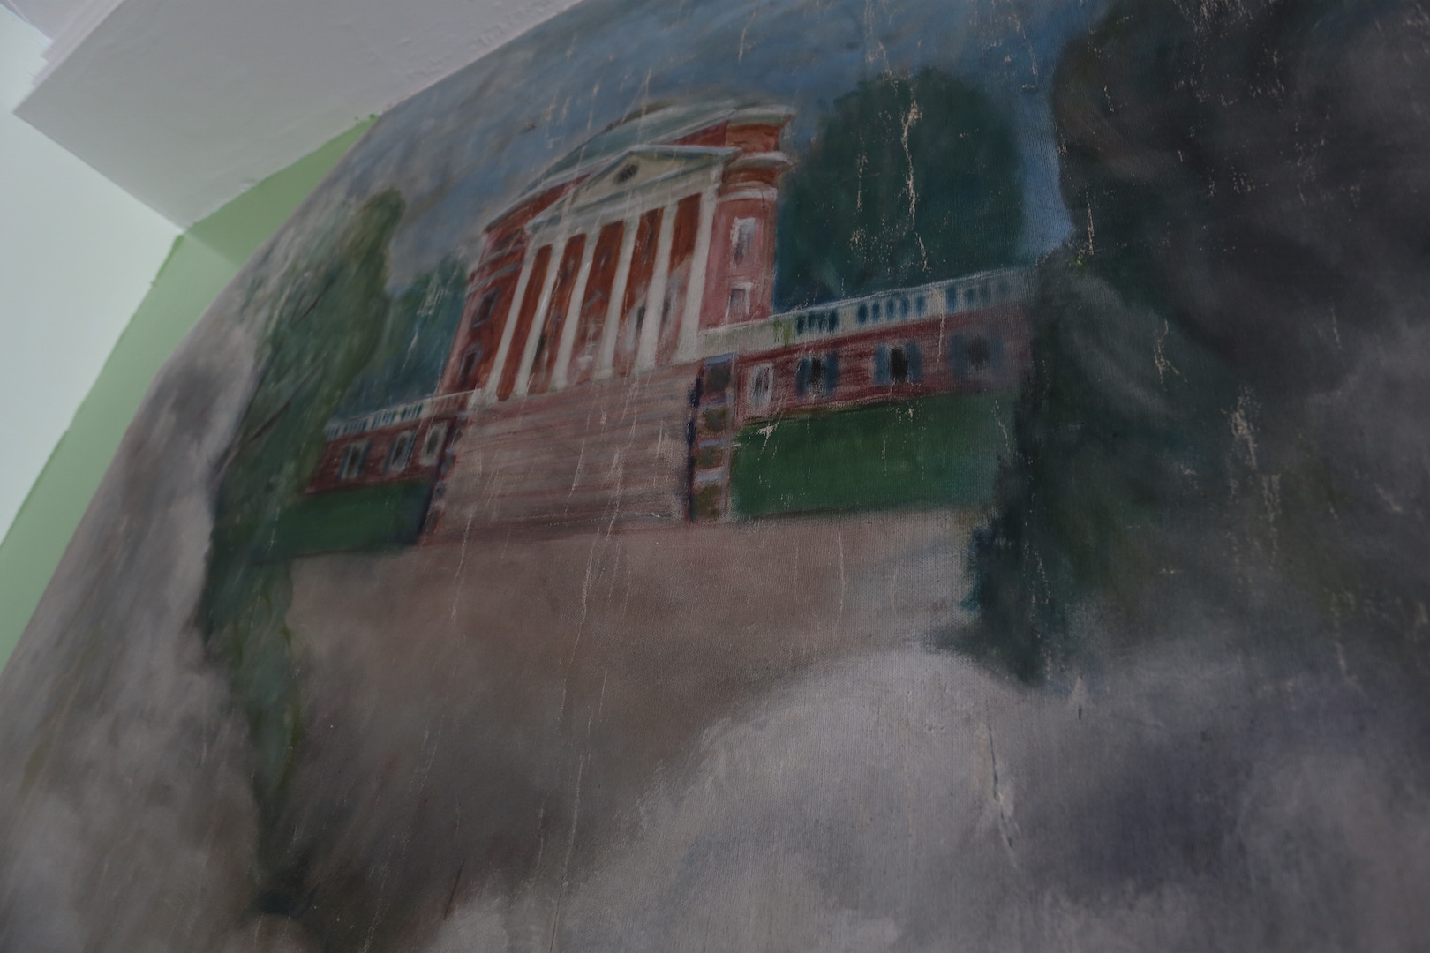
Part of Mural Before Renovation

Slide 8
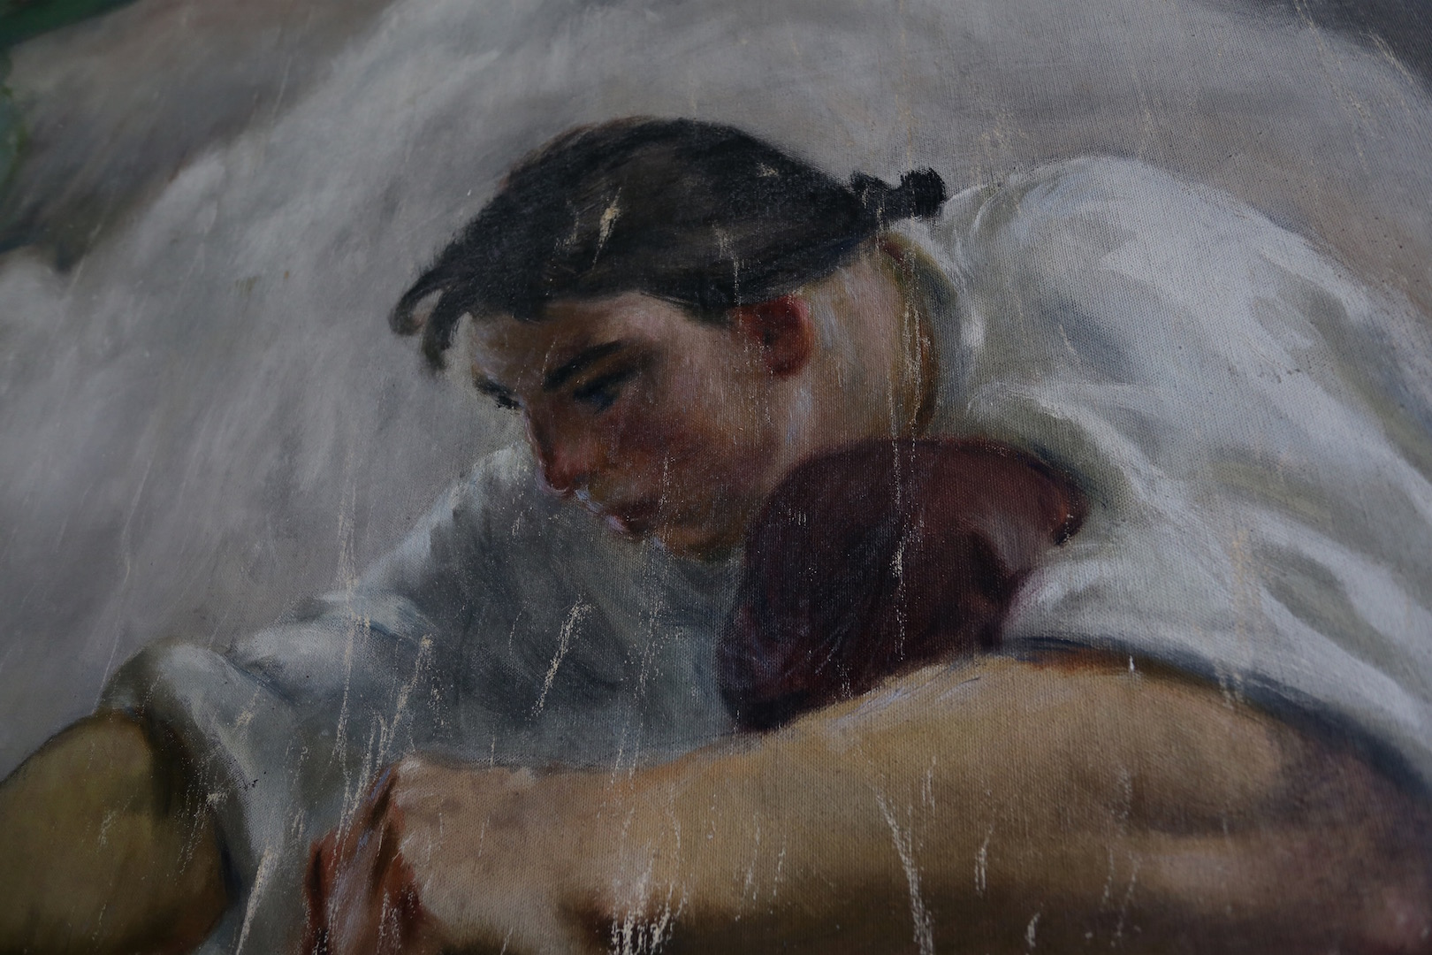
Another photo of part of the mural before renovation.

Slide 9
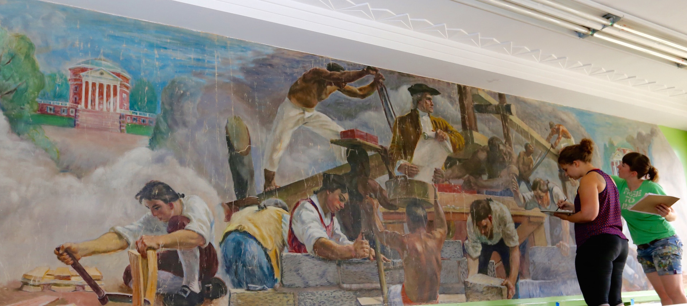
This photo shows the professional artists doing the renovations to the mural
this summer.
The original 1941 specifications for the mural required it contain various elements
such as aspects of Mr. Jefferson himself, Monticello and more.
The two artists in the photograph are painting from scaffolding.

Slide 10
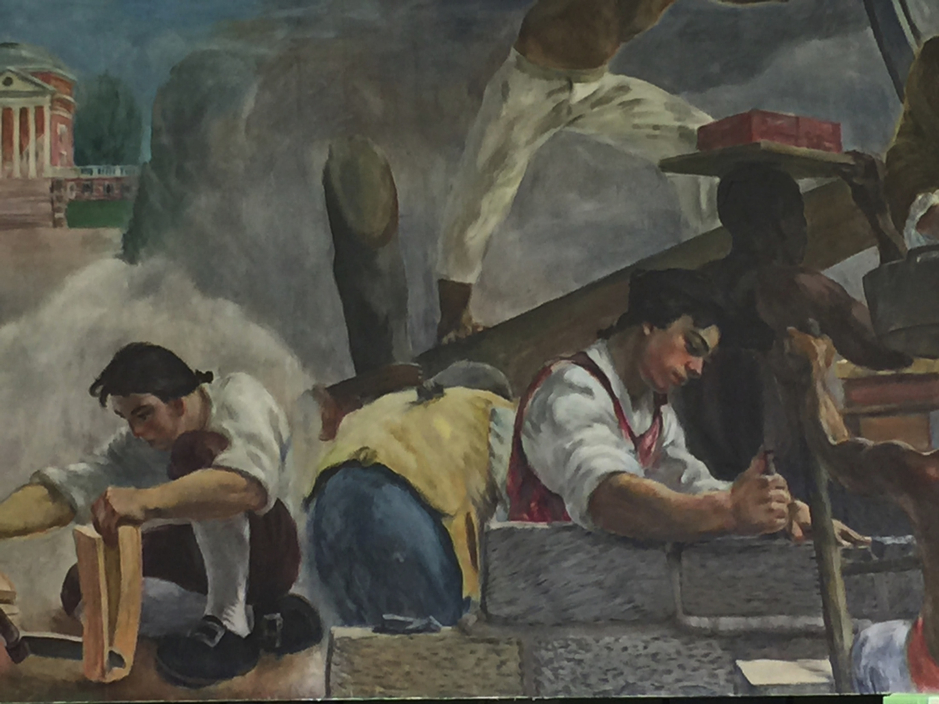
This photo shows aspect of mural after renovation completed.
Next slide also shows completed renovations.

Slide 11
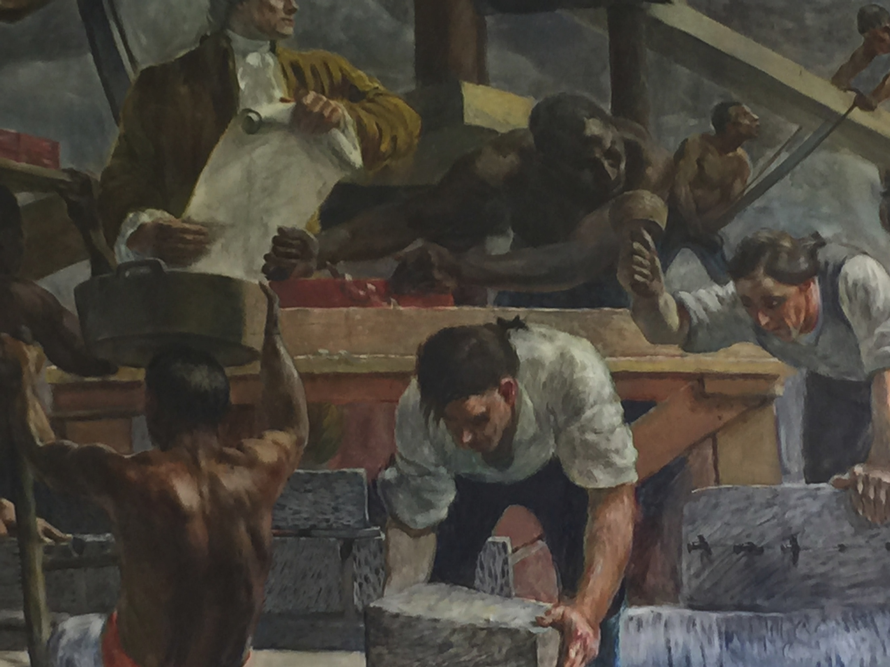

Slide 12
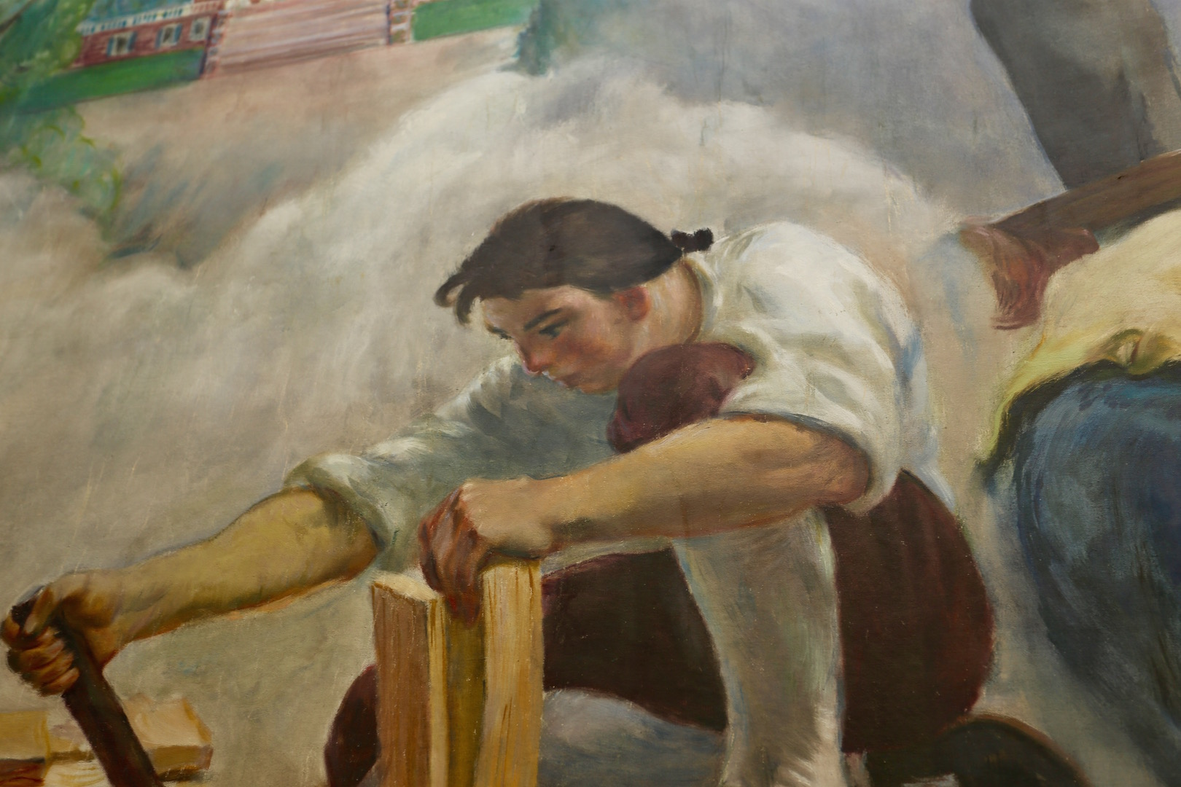
After renovation..

Slide 13
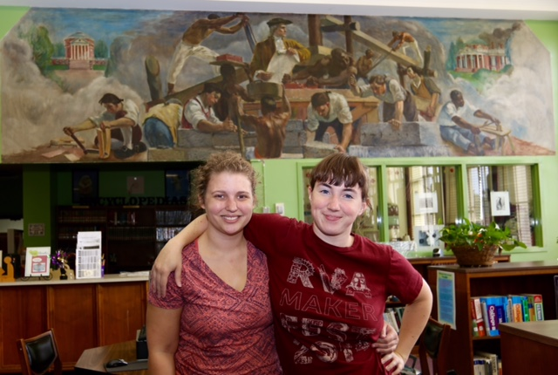
The two professional artists on the mural project, Emily Herr & Alicia Hagy,
celebrate project completion.

Slide 14
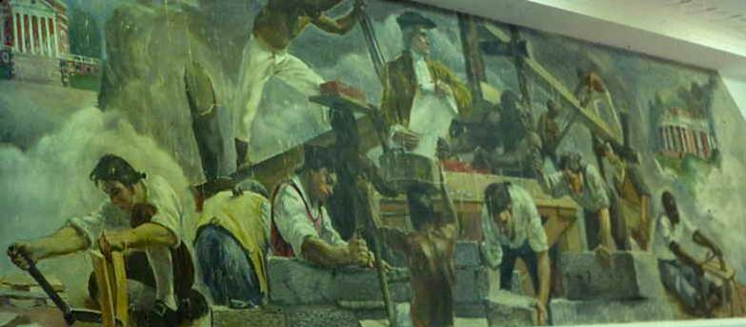
This view shows the mural with renovations completed.
Many thanks to Russell Flammia (‘62) and some of his friends for running over
to the school and snapping these photos for us to share with you!

Slide 15
The End
Slide presentation created and sent to you from Class of ’64 Web Administrator

